Slide 1

A COMPARATIVE STUDY ON DISTRIBUTED FILE SYSTEMS
Department of Computer Engineering
TERNA ENGINEERING COLLEGE
Nerul (W), Navi Mumbai 400706
PRESENTATION
Group Members:
Under the Guidance of : Prof. Rohini Patil
Amey Thakur
Hasan Rizvi
Mega Satish
B-50
B-51
B-58

Slide 2
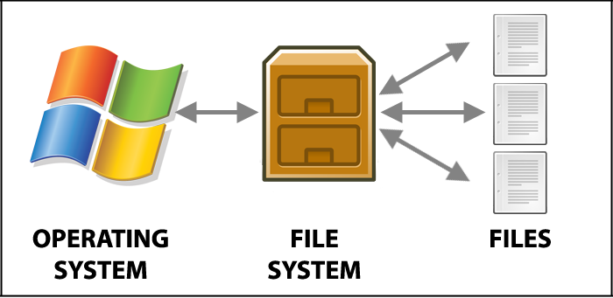
AGENDA
Abstract
Introduction
Literature Survey
Network File System (NFS)
Andrew File System (AFS)
Google File System (GFS)
Hadoop Distributed File System (HDFS)
Comparison
Conclusion
References

Slide 3
ABSTRACT
Distributed File Systems are the backbone of how large volumes of data are stored.
Hadoop File Systems, Google File Systems, and Network File Systems have all shifted the way data is maintained on servers.
In terms of performance, fault tolerance, consistency, scalability, and availability, each file system has its own set of benefits and drawbacks.
This paper examines a file system comparison research and suggests a criterion for selecting a certain file system. The paper also looks into the pros and drawbacks of using a file system.

Slide 4
INTRODUCTION
A Distributed File System is a client/server programme that allows clients to access and process data stored on various servers while responding to them as if they were on a local system.
This sort of file system centralises files from several servers into a single global directory.
When a client requests the most recent version of the data, the Distributed Files System has a system in place to avoid conflicts and try to share the most recent version of the data.
Transparency, flexibility, dependability, performance, scalability, and security are all variables to consider while creating such systems, as are Architecture, Processes, Communication, Naming, Synchronization, Caching & Replication, and Fault Tolerance techniques.

Slide 5
LITERATURE SURVEY
Year | Paper | Summary
2017 | “An Efficient Cache Management Scheme for Accessing Small Files in Distributed File Systems" by Kyuongsoo Bok, Hyunkyo Oh, Jongtae Lim and Jaesoo Yoo | They presented a distributed store the executives plot in Hadoop Distributed File Systems that takes into account reserve information for effective gets of little documents (HDFS).
2019 | An Efficient Ring-Based Metadata Management Policy for Large-Scale Distributed File Systems" by Yuanning Gao, Xiaochun Yang, Jiaxi Liu and Guihai Chen | They proposed AngleCut, a new hashing algorithm for segmenting metadata namespace trees and serving massive scope communicated capacity frameworks.

Slide 6
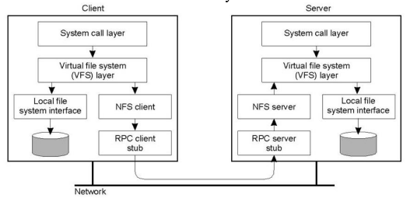
NETWORK FILE SYSTEM (NFS)
Network File System is a mechanism for storing files on network. It is a distributed file system that allows users to access files and directories located on remote computers and treat those files and directories as if they were local. For eg., users can use os commands to create, remove, read, write and set file attributes for remote files and directories.
Architecture of NFS

Slide 7
NETWORK FILE SYSTEM (NFS)
Features of NFS:
Enables multiple computers to use same files, so everyone on the network can access the same data.
Reduces storage costs by having computers share applications instead of needing local disk space for each user application.
Provides data consistency and reliability because all users can read the same set of files.
Makes mounting of file systems transparent to users.
Makes accessing of remote files transparent to users.
Supports heterogeneous environment.
Reduces system administration overhead.

Slide 8
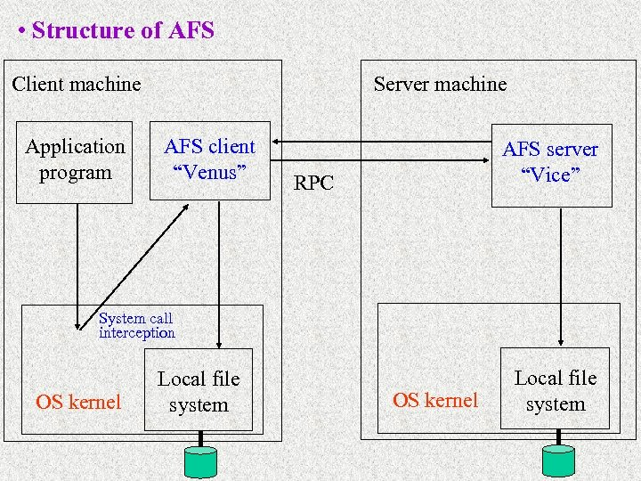
ANDREW FILE SYSTEM (AFS)
Andrew File System began as part of a bigger Andrew project. It was originally known as "Vice" and was created by Carnegie Mellon University. This was primarily created for computers that run BSD, UNIX, or Mach operating systems.
Andrew File System work is now being carried out as part of the OpenAFS project. This software is compatible with a variety of platforms, including Linux, Apple Mac OS X, Sun Solaris, and Microsoft Windows NT.
Structure of AFS

Slide 9
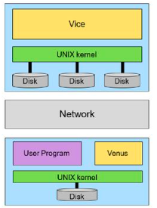
ANDREW FILE SYSTEM (AFS)
Vice (Server)
Serve files to Venus
A set of trusted servers, collectively called Vice
A process running on server side
Vice process dedicated to each Venus client
Venus (Client)
Cache files from Vice
Contacts Vice only when a file is opened or closed
Reading and writing are performed directly on the cached copy (client side)

Slide 10
ANDREW FILE SYSTEM (AFS)
Features of AFS:
File Backups: AFS data files are backed up nightly. Backups are kept on site for six months.
File Security: AFS data files are protected by the Kerberos authentication system.
Physical Security: AFS data files are stored on servers located in the UCSC data center.
Reliability and Availability: AFS servers and storage are maintained on redundant hardware.
Authentication: AFS uses Kerberos for authentication. Kerberos accounts are automatically provisioned for all UCSC students, faculty and staff. Kerberos uses the CruzID ‘blue’ password.

Slide 11
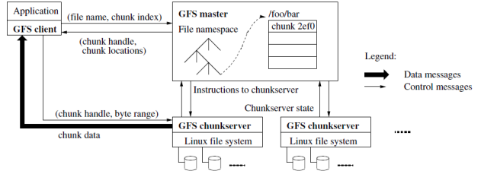
GOOGLE FILE SYSTEM (GFS)
Google File System is made up of groups that contain a large number of storage servers that were built using less expensive tools and technologies and operate on a cluster-based approach. The files are dumped in tree-like structures with path names to differentiate them.
Architecture of GFS

Slide 12
GOOGLE FILE SYSTEM (GFS)
Google File System Characteristics:
Error tolerance
Copying mechanism of important data
Self-reliant data backup and recovery
Larger productivity
Less communication of primary and sub-category servers because of block server
Identification mechanism and authorization scenarios
Significant presence and lesser downtime
GFS clusters with more than 1,000 nodes and 300 TB of disc storage capacity are the most powerful. This can be accessed by hundreds of clients on a continuous basis.

Slide 13
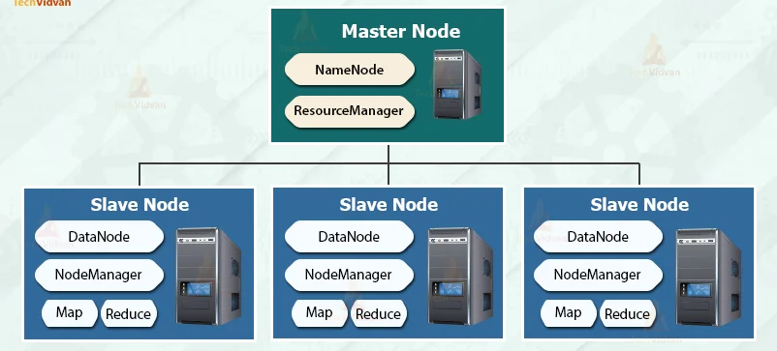
HADOOP DISTRIBUTED FILE SYSTEM (HDFS)
Hadoop Distributed File System is a free and open-source version of the Google File System. It grants greater information productive rights and is primarily designed for web services that contain large data sets. For eg, Facebook, eBay, LinkedIn, and Twitter are web companies that use Hadoop File System to manage big data volumes and project requirements for data analytics.
Architecture of HDFS

Slide 14
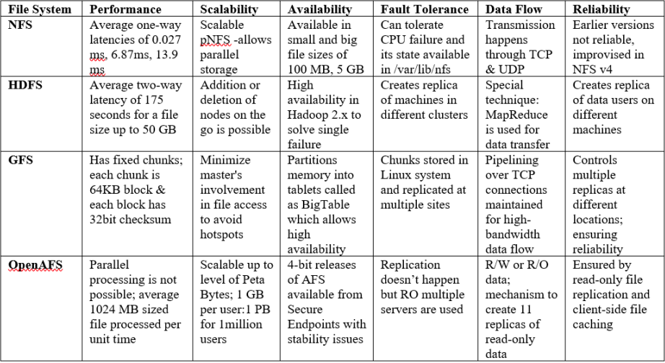
COMPARISON

Slide 15
What we learnt from this paper?
We studied different types of file systems.
GFS | NFS | AFS
CLuster based architecture | Client Server based architecture | CLuster based architecture
No caching | Client and server caching | Client caching
Not similar to Unix | Similar to Unix | Similar to Unix
File data is stored across different chunk servers thus reads come from different chunk servers | Reads come from same server | Reads come from same server
Server Replication | No replication | Server Replication
Location independent namespace | Not location independent namespace | Location independent namespace
Lease based locking | Lease based locking | Lease based locking

Slide 16
CONCLUSION
There are many different file systems, and this paper compares a few of them: NFS, AFS, GFS, and HDFS.
With great performance, availability, and a powerful file replication method against fault tolerance, HDFS is the most preferred option.
In terms of scalability and the use of chunks of data for pipelining transmission via TCP channels, GFS is the second preferred option.
NFS is a bit more popular since it is an older file system that consumers believe to be more reliable, however OpenAFS also has several user-friendly features like scalability.

Slide 17
REFERENCES
[1] De, Suman, and Megha Panjwani. "A Comparative Study on Distributed File Systems." In Modern Approaches in Machine Learning and Cognitive Science: A Walkthrough, pp. 43-51. Springer, Cham, 2021.
[2] Y. Gao, X. Gao, X. Yang, J. Liu and G. Chen, "An Efficient Ring-Based Metadata Management Policy for Large-Scale Distributed File Systems," in IEEE Transactions on Parallel and Distributed Systems, vol. 30, no. 9, pp. 1962-1974, 1 Sept. 2019, doi: 10.1109/TPDS.2019.2901883
[3] Kyoungsoo Bok, Jongtae Lim, Hyunkyo Oh and Jaesoo Yoo, "An efficient cache management scheme for accessing small files in Distributed File Systems," 2017 IEEE International Conference on Big Data and Smart Computing (BigComp), Jeju, 2017, pp. 151-155, doi: 10.1109/BIGCOMP.2017.7881731
[4] M. Nithya and N. U. Maheshwari, "Load rebalancing for Hadoop Distributed File System using distributed hash table," 2017 International Conference on Intelligent Sustainable Systems (ICISS), Palladam, 2017, pp. 939-943, doi: 10.1109/ISS1.2017.8389317
[5] L.Sudha Rani, K.Sudhakar, S.Vinay Kumar, “Distributed File Systems: A Survey”, International Journal of Computer Science and Information Technologies, Vol. 5(3), 2014, 3716-3721

Slide 18
THANK YOU

